Slide 1
Design-Centric Maze Generation
Paul Hyunjin Kim, Jacob Grove, Skylar Wurster, Roger Crawfis
The Ohio State University
{kim.3983, grove.217, wurster.18, crawfis.3}@osu.edu

Slide 2
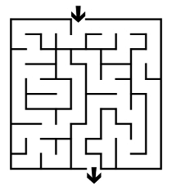
What is Maze?
Puzzle
Simple Goal
Find a path from an entrance to a goal

Slide 3
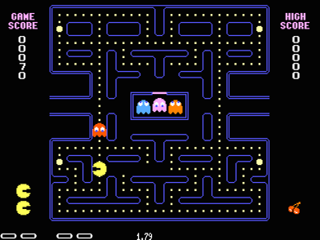
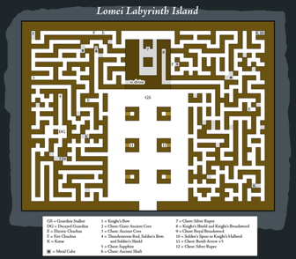
Maze as a tool
Computer Game
Pac-Man
The Legend of Zelda

Slide 4
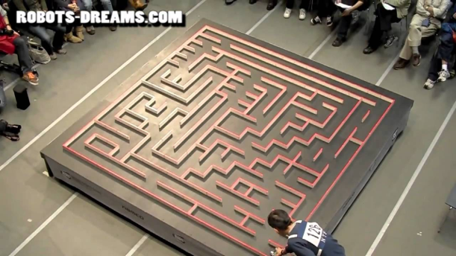
Maze as a tool
Robot Contest
Micromouse (micromouseusa.com)

Slide 5
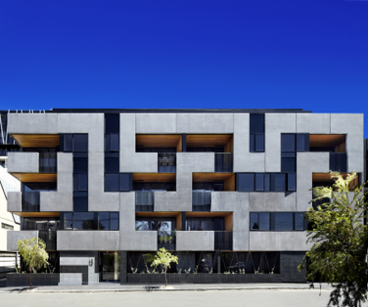
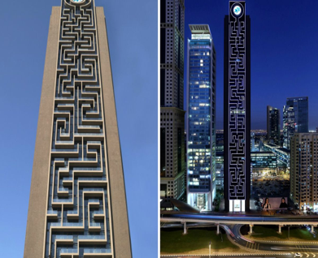
Maze as a tool
Architecture
Maze Apartment
Maze Building

Slide 6
Different Properties of Maze
Mazes are used in different fields
Maze with different properties can be wanted

Slide 7
Different Purposes of Maze
Racing Game
Maze with long straight-ways
Robot Contest
Maze with complicated paths with many decisions

Slide 8
Goal
Develop design-centric maze generation tool
Using the tool, users can input their own desired properties and have desired maze.
Notes:
So that

Slide 9
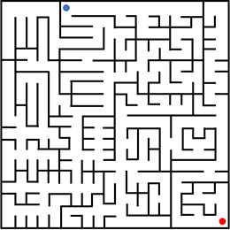
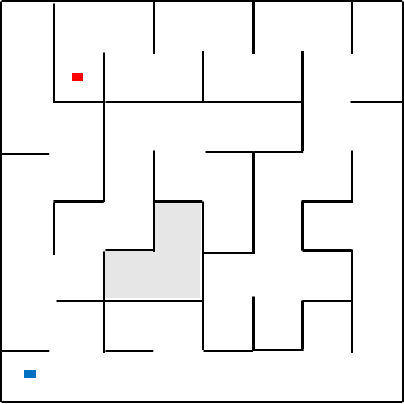
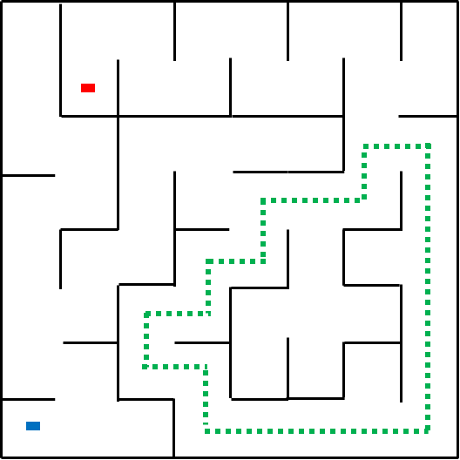
Research Domain
Rectangular Perfect Maze
No Loops
No Inaccessible Areas

Slide 10
Motivation
Case that has detailed design criteria
Want lots of branches on a maze
Also, want the solution path with many curves on a maze

Slide 11
Motivation
Perfect mazes can be generated by existing randomized maze generation algorithms.
But, very difficult to achieve the desired maze with the random algorithms.

Slide 12
Research Domain
Maze Cell of Perfect Maze
Notes:
Let’s look at the perfect maze more

Slide 13
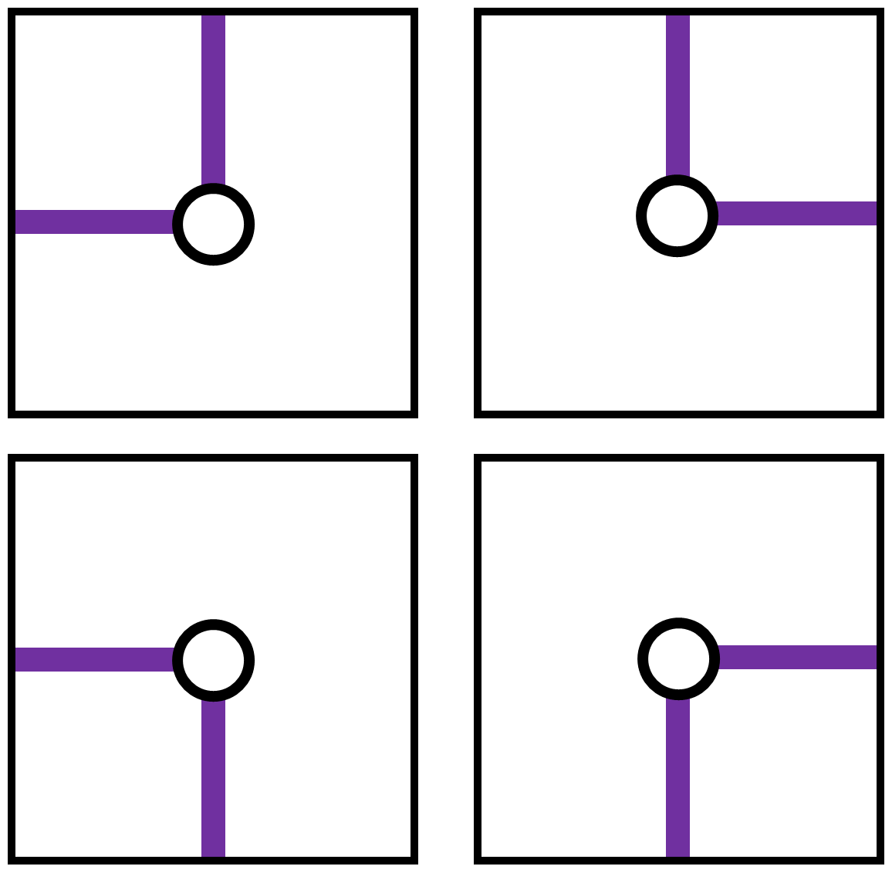
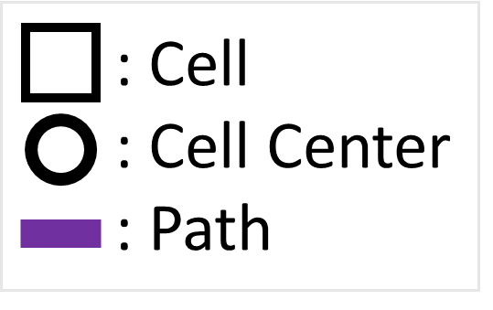
Research Domain
Maze Cell of Perfect Maze
Turn
Notes:
So, inside colored thing is passage way of perfect maze

Slide 14
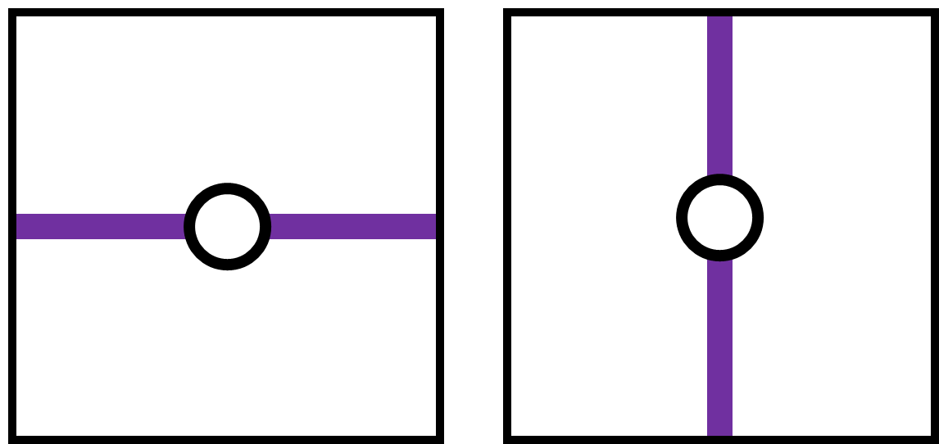
Research Domain
Maze Cell of Perfect Maze
Turn
Straight
Notes:
So, inside colored thing is passage way of perfect maze

Slide 15
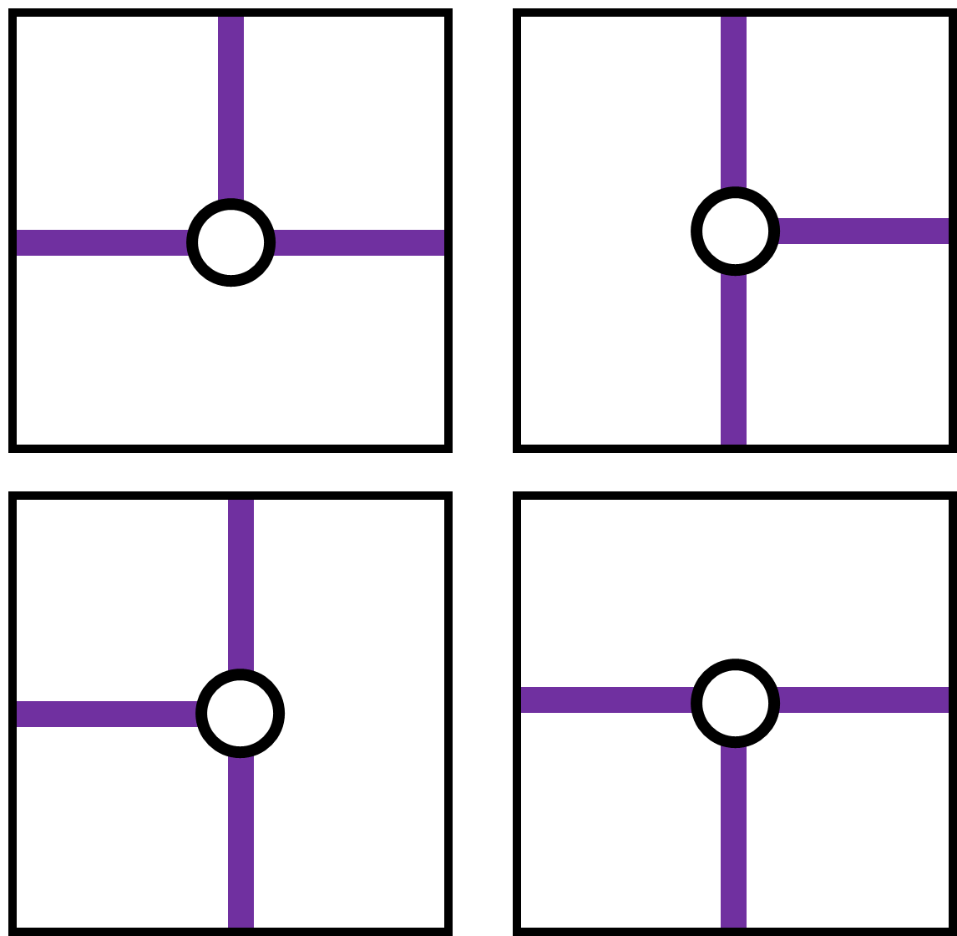
Research Domain
Maze Cell of Perfect Maze
Turn
Straight
T-Junction
Notes:
So, inside colored thing is passage way of perfect maze

Slide 16
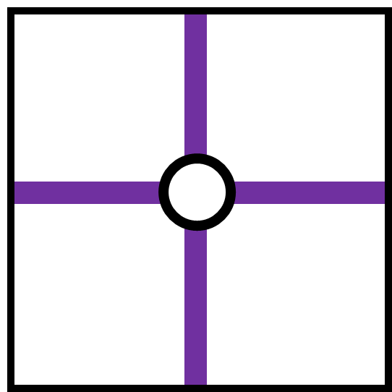
Research Domain
Maze Cell of Perfect Maze
Turn
Straight
T-Junction
Cross-Junction
Notes:
So, inside colored thing is passage way of perfect maze

Slide 17
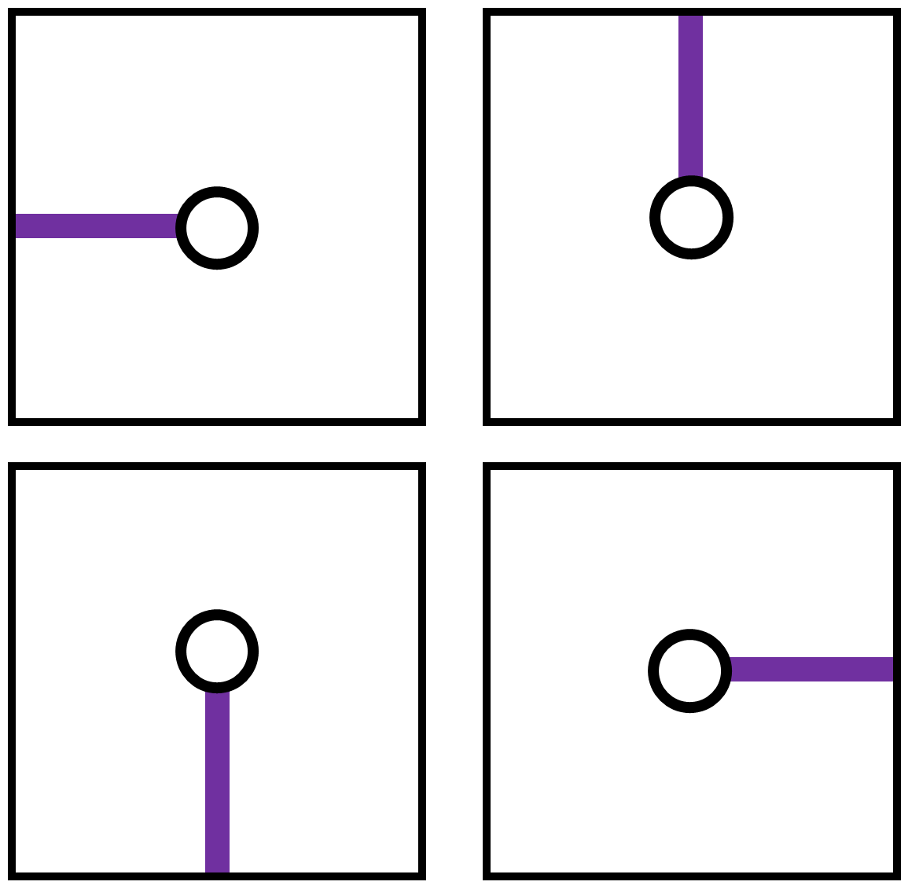
Research Domain
Maze Cell of Perfect Maze
Turn
Straight
T-Junction
Cross-Junction
Terminal
Notes:
Cell with start point and end point also considered as dead-end cells

Slide 18
Research Domain
Perfect maze can be generated from spanning tree on regular grid.

Slide 19
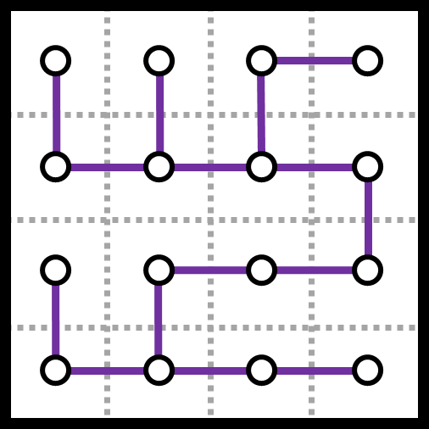
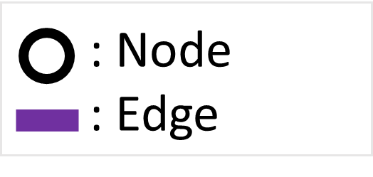
Research Domain
Spanning Tree on Regular Grid
No loops
No inaccessible nodes

Slide 20
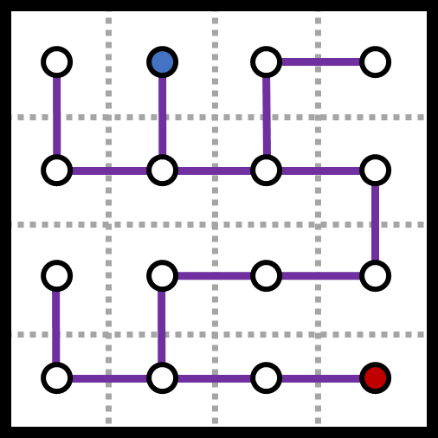
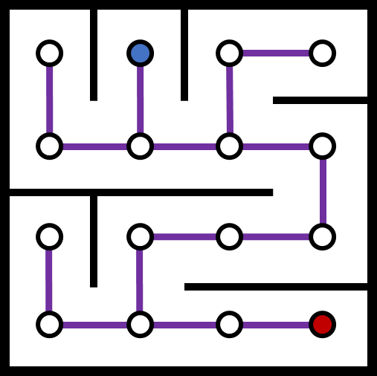
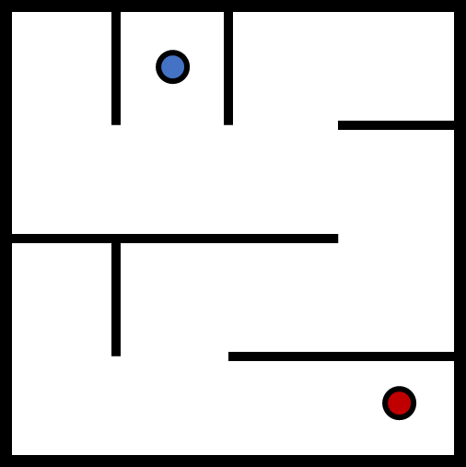

Research Domain
Perfect Maze from Spanning Tree

Slide 21
Spanning Tree and Perfect Maze
Duality of Spanning Tree and Perfect Maze

Slide 22
Design-Centric Maze Generation
Three Stages
Input
Maze & Solution Path Generation
Output
Notes:
In this tool,,,,

Slide 23
Design-Centric Maze Generation
Input
Desired Properties of Maze
Desired Properties of Solution Path
Notes:
High level property

Slide 24
Maze Properties
Setting up desired values for maze metrics
#Turns
#Straights
#T-Juncs
#Cross-Juncs
#Terminals

Slide 25
Solution Path Properties
Setting up desired values for path metrics
#Turns
#Straights
#T-Juncs
#Cross-Juncs
SolutionPathLength

Slide 26
Design-Centric Maze Generation
Three Stages
Input
Maze & Solution Path Generation
Output
Notes:
In this tool,,,,

Slide 27
Maze Generation
To generate desired maze
Use Search-based Procedural Content Generation

Slide 28
Search-based Procedural Content Generation
Search-based Procedural Content Generation(SBPCG)
One approach of PCG
Special case of generate-and-test approach

Slide 29
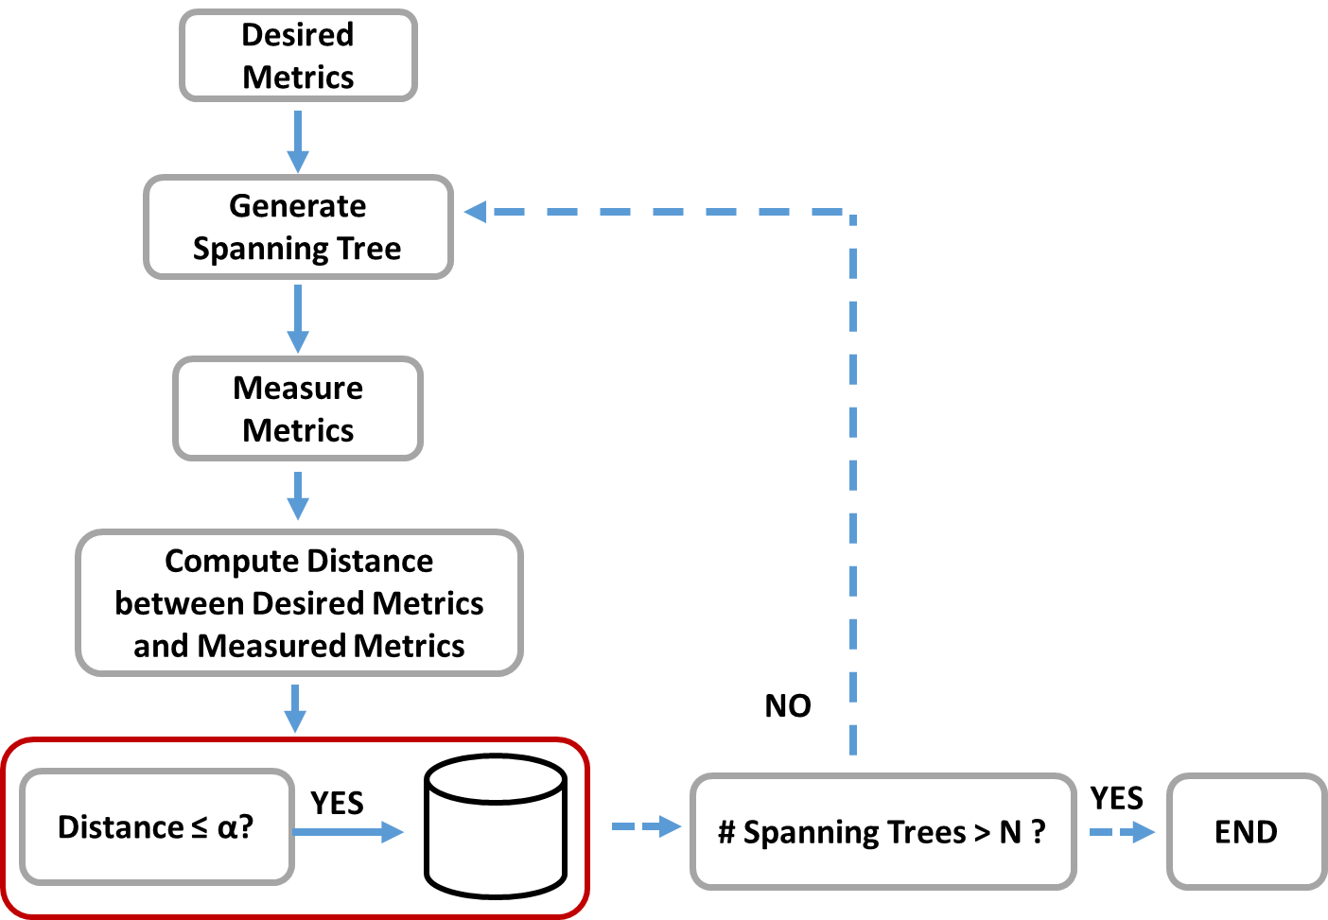
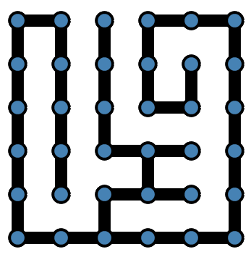

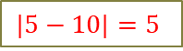
Search-based Procedural Content Generation
SBPCG to find desired maze
Intelligent Maze Generation
#Turns = 5
#Turns = 10
$$|5−10|=5$$

Slide 30
Intelligent Maze Generation
Searching over all possible spanning trees → 32 trillion of spanning trees in 6x6 grid
Spanning tree space
Notes:
Spanning tree space vs metric vector space

Slide 31
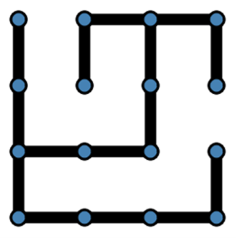
Metric Vector Space
Metric vector: (#Turns, #Straights, #T-Junctions, #Cross-Junctions, #Terminals)
→ Metric Vector = (5, 5, 2, 0, 4)
Notes:
Spanning tree space vs metric vector space

Slide 32
Metric Vector Space
#Metric Vectors in Spanning Tree Space
#SpanningTrees (32 trillion) >>> #MetricVectors(1,273)
 | #Metric Vectors
3x3 | 11
4x4 | 90
5x5 | 385
6x6 | 1,273

Slide 33
Metric Vector Space
Represent spanning tree space with metric vectors
Spanning tree space
Notes:
Spanning tree space vs metric vector space

Slide 34
Metric Vector Space
Represent spanning tree space with metric vectors
Spanning tree space
Notes:
Spanning tree space vs metric vector space

Slide 35
Metric Vector Space
Represent spanning tree space with metric vectors
Notes:
Spanning tree space vs metric vector space

Slide 36
Metric Vector Space
Represent spanning tree space with metric vectors
Metric vector space

Slide 37
Metric Vector Space
Searching over metric vector space → Can facilitate finding desired mazes
Metric vector space

Slide 38

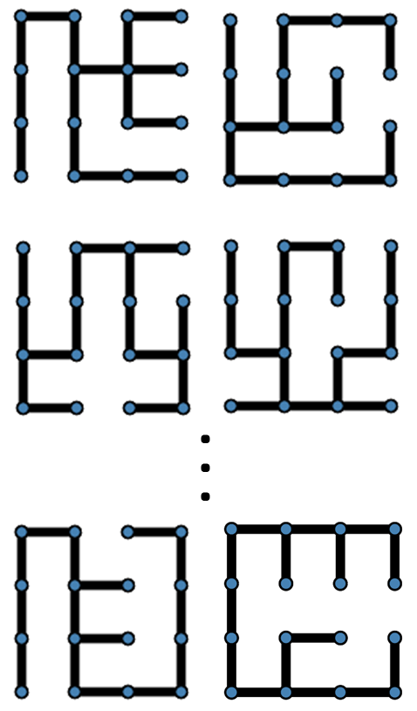
Intelligent Maze Generation
Overview
Spanning trees
with mv
Desired
Metrics
mv
Desired Maze
Metric vector space

Slide 39
Intelligent Maze Generation
How to reconstruct spanning trees from mv?
mv
Spanning trees
with mv
Metric vector space

Slide 40
How to reconstruct spanning trees
Intelligent Representative Machine
?
Metric Vector mv
!
Spanning trees
with mv
Notes:
For each metric value, learn how to represent corresponding spanning trees

Slide 41
New intelligent method
Intelligent Representative Machine
!
mv
Spanning trees
with mv
Metric vector space
Notes:
High probability to have desired spanning trees

Slide 42
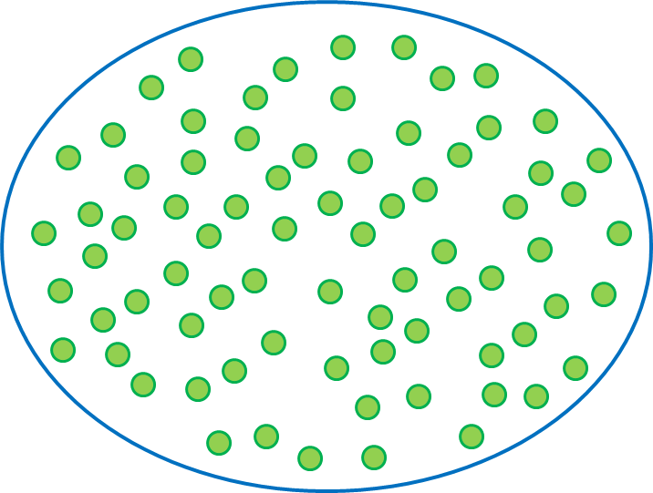

Intelligent Representative Machine
Building with objective function f
$f={DIFF}_{avg}+(α−UT)$
Metric Vector
Intelligent Representative Machine
Space of all possible spanning trees
Notes:
When intelligent sampling machine is constructed,… it is learning with objective function f

Slide 43
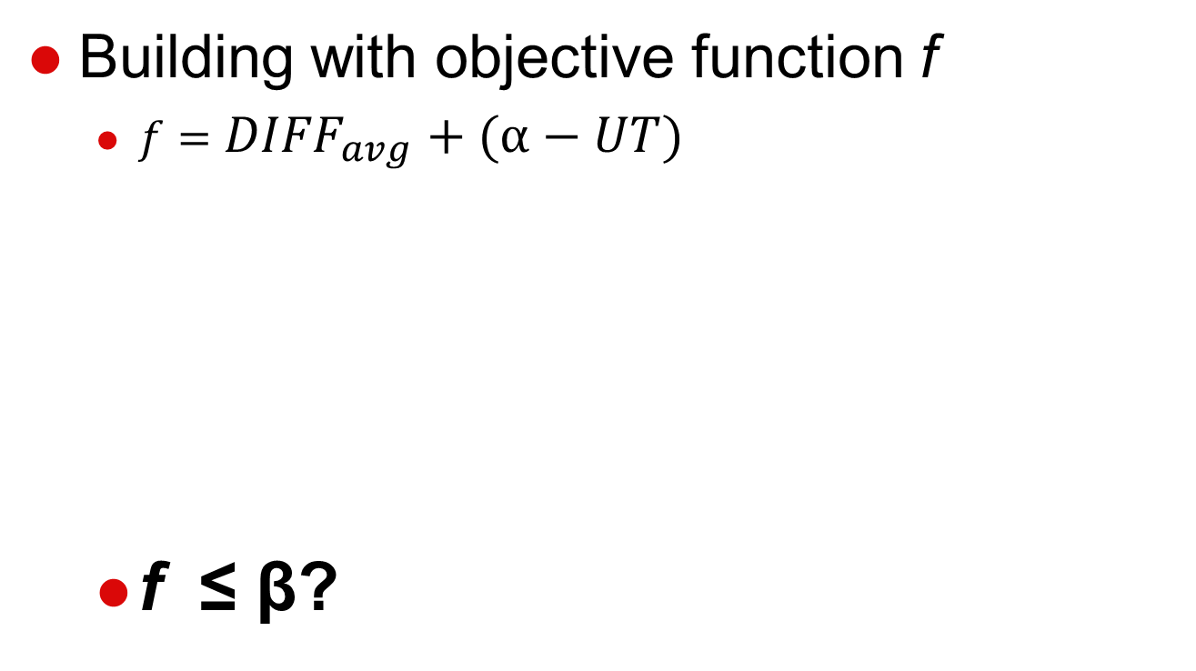
Intelligent Representative Machine
Building with objective function f
$f={DIFF}_{avg}+(α−UT)$
f ≤ β?
Metric Vector
Intelligent Representative Machine
Space of all possible spanning trees

Slide 44
Intelligent Representative Machine
Building with objective function f
$f={DIFF}_{avg}+(α−UT)$
Metric Vector
Intelligent Representative Machine
Space of all possible spanning trees

Slide 45
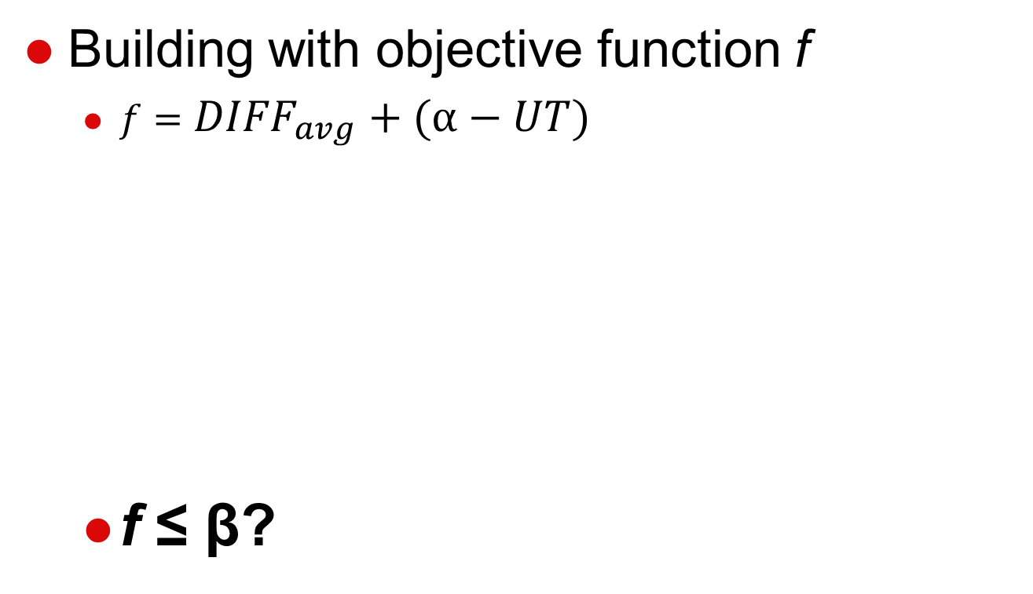
Intelligent Representative Machine
Building with objective function f
$f={DIFF}_{avg}+(α−UT)$
f ≤ β?
Metric Vector
Intelligent Representative Machine
Space of all possible spanning trees

Slide 46
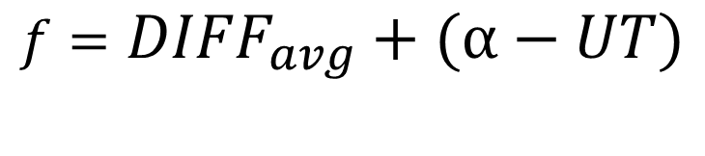
Objective Function f
$$f={DIFF}_{avg}+(α−UT)$$
Ensures to have spanning trees close to desired spanning tree

Slide 47
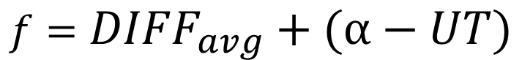
Objective Function f
$$f={DIFF}_{avg}+(α−UT)$$
Ensures to have spanning trees with diverse topologies.

Slide 48
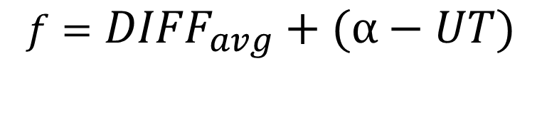
Objective Function f
$$f={DIFF}_{avg}+(α−UT)$$
Minimum value of f
Ensures to generate spanning trees with various topologies close to desired spanning tree
Notes:
When machine has minimum value of f

Slide 49
Issue with Large Grid
Our intelligent method builds representative machines from enumerated space (space of all possible spanning trees)
Size of enumerated space
6x6 grid: 32 trillion of spanning trees
> 6x6 grid: ???

Slide 50
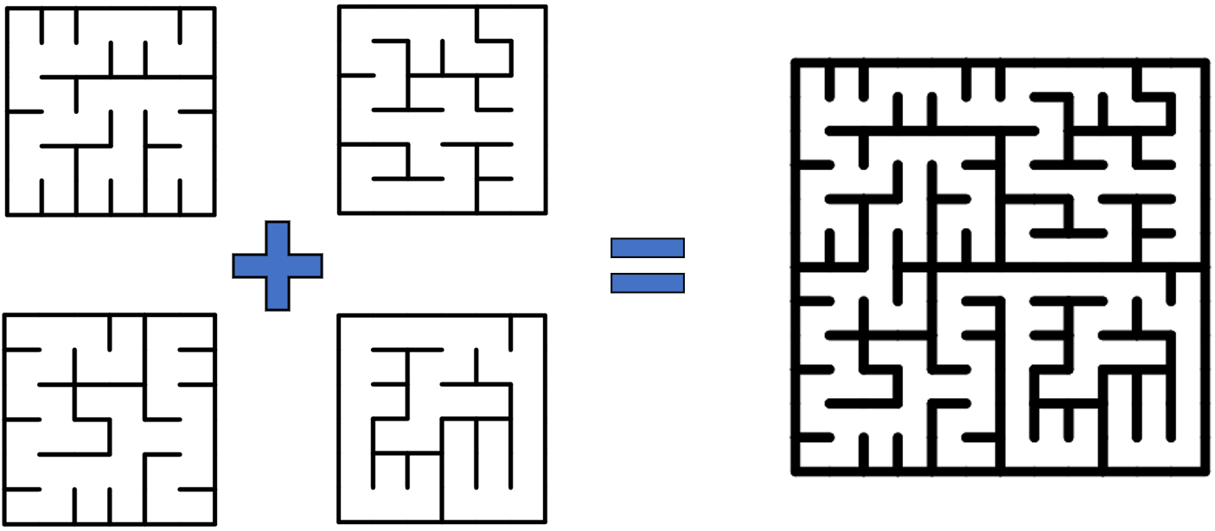
Hierarchical Maze
Use hierarchical maze concept
Notes:
Where small size of mazes are stitched into large maze

Slide 51
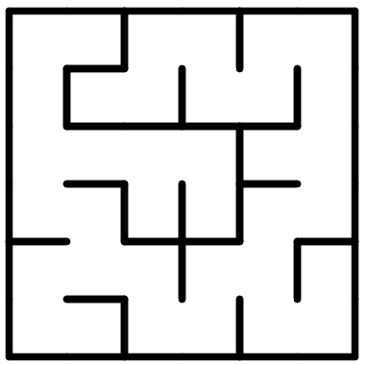
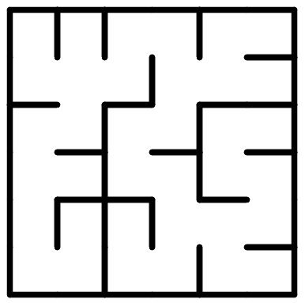
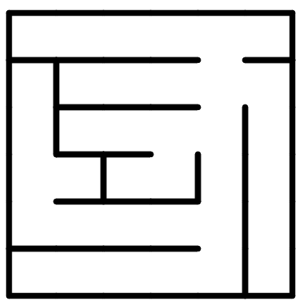
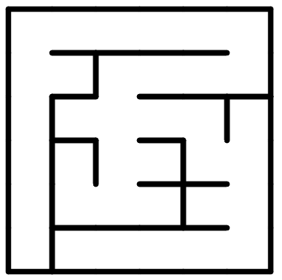
Hierarchical Maze
Small Mazes Generation
#T-Junctions = 5
(6x6 grid)
#T-Junctions = 5
(6x6 grid)
#T-Junctions = 20
(12x12 grid)
#T-Junctions = 5
(6x6 grid)
#T-Junctions = 5
(6x6 grid)

Slide 52
Hierarchical Maze
Stitching
Boundary Selection

Slide 53
Hierarchical Maze
Stitching
Boundary Selection
Notes:
We can randomly knock down wall on each boundary… depending on wall measured metric can be changed

Slide 54
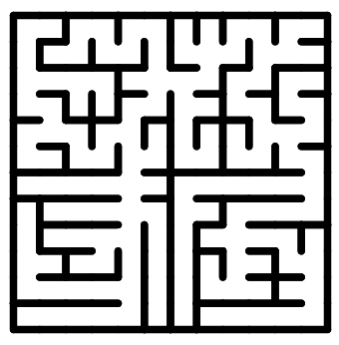
Hierarchical Maze
Large Maze
Notes:
When we stitch 6x6 mazes…

Slide 55
Performance Demonstration
Choice-based Maze Generation Method
Intelligent Maze Generation Method
Demonstrate whether they generate mazes on target in a 18x18 grid
Generate 1,000 mazes in a 18x18 grid
2D Histograms
VS
Notes:
To show performance of our maze generation method.

Slide 56
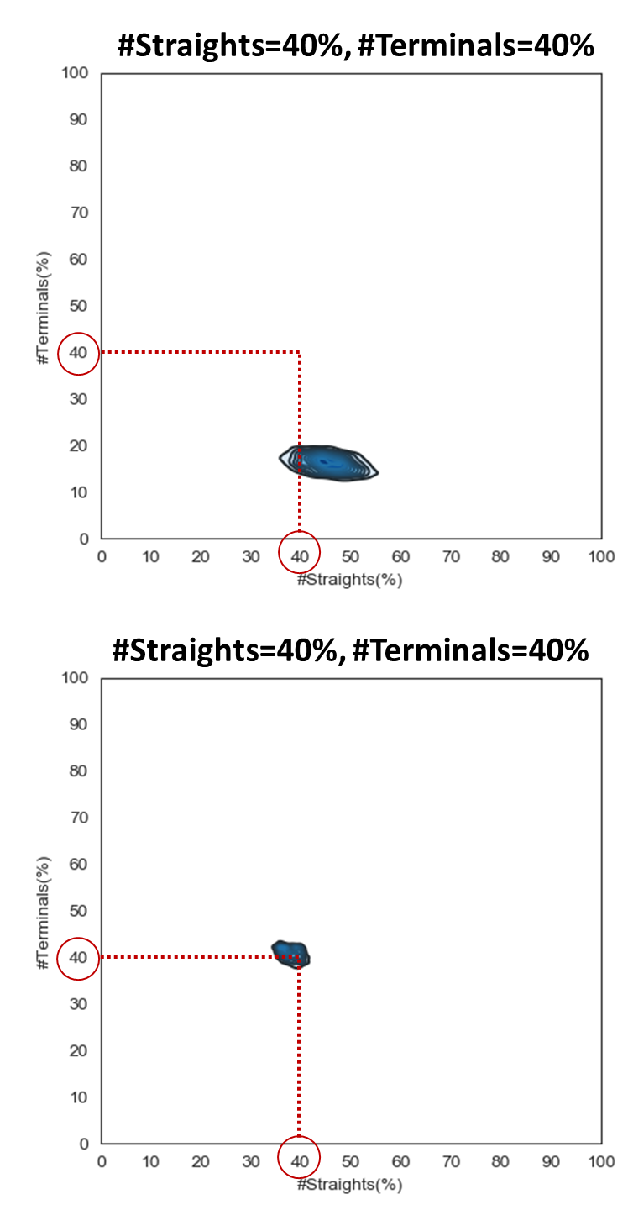
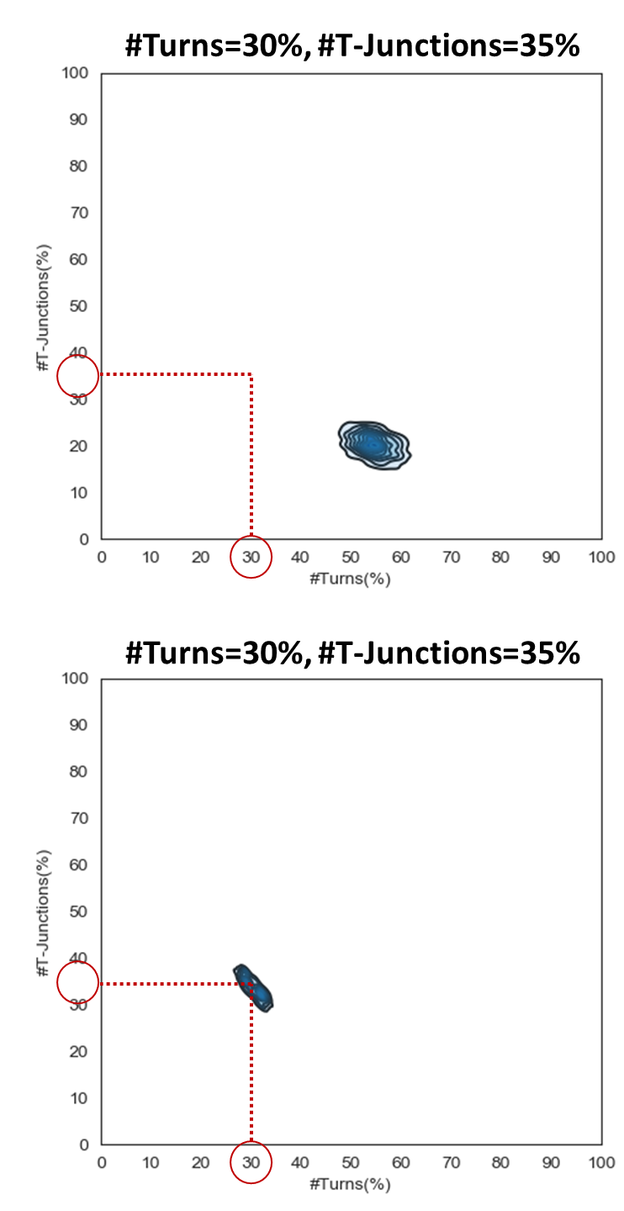
Performance Demonstration
25
20
Choice-
based
Method
15
12
0
0
80
72
Intelligent Method
48
40
0
0
Notes:
Legend sample size: 1,000

Slide 57
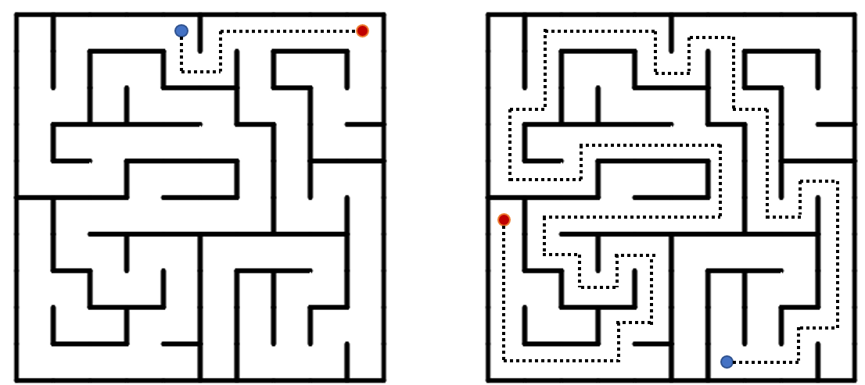
Solution Path Generation
Playing quality can be different based on the solution path
Gives control over solution path topology

Slide 58
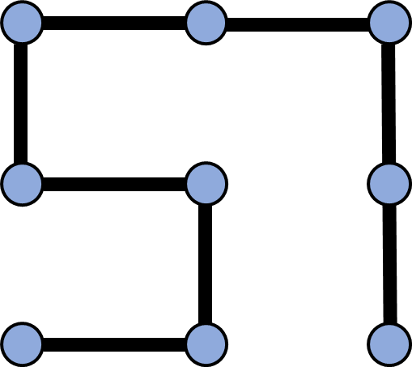
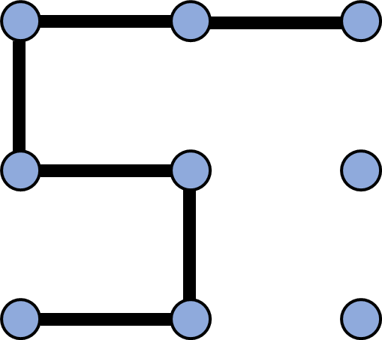
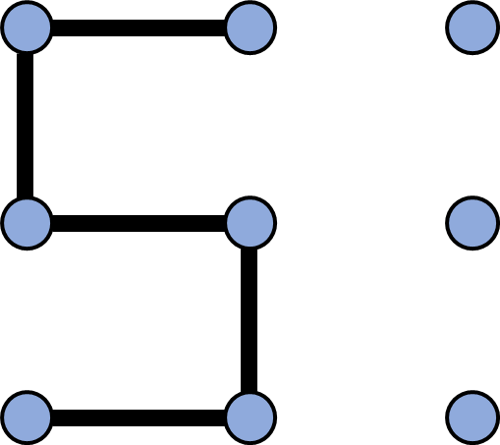
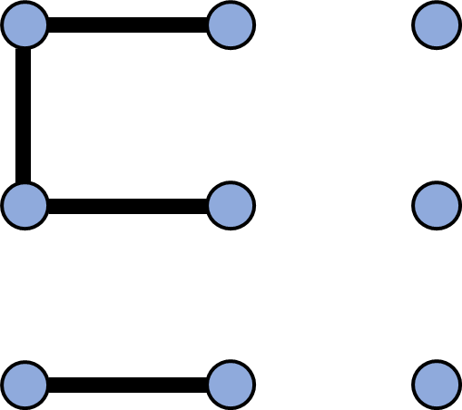
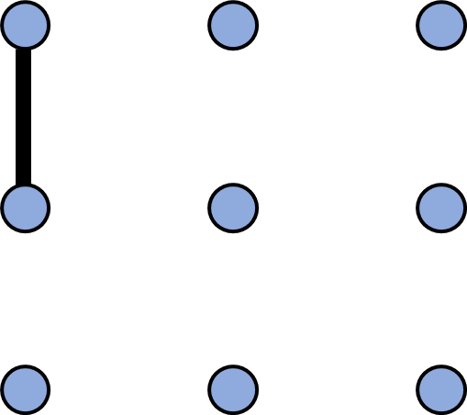
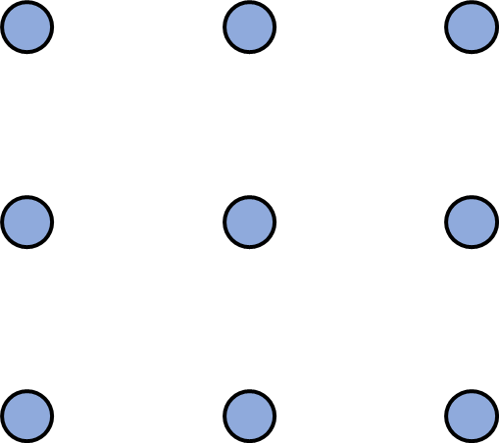
Path Generation
Column-Sweeping Technique
Column 0
3x3 Grid
Column 1
Column 2
Notes:
Can apply column-sweeping too here again

Slide 59
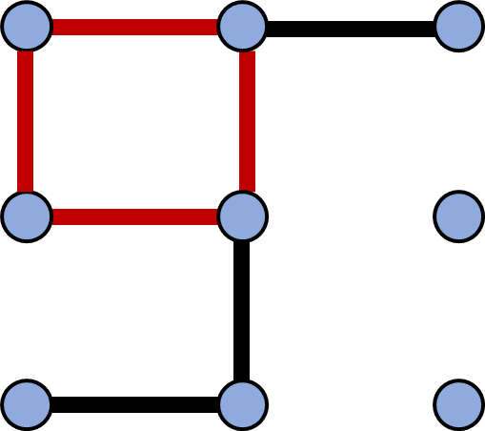
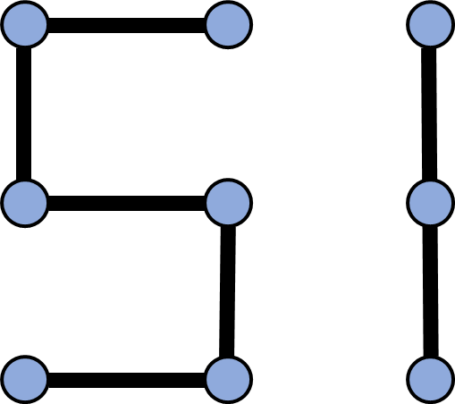
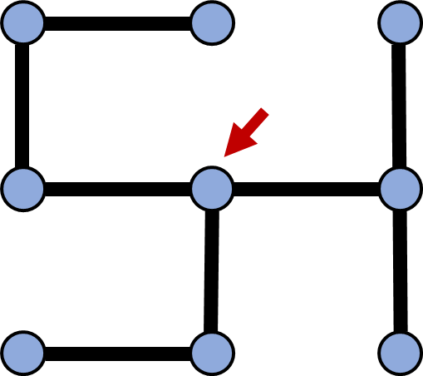
Path Generation
During column-sweeping, disallow loops, disconnects, and junctions
Loop
Disconnect
Junction

Slide 60
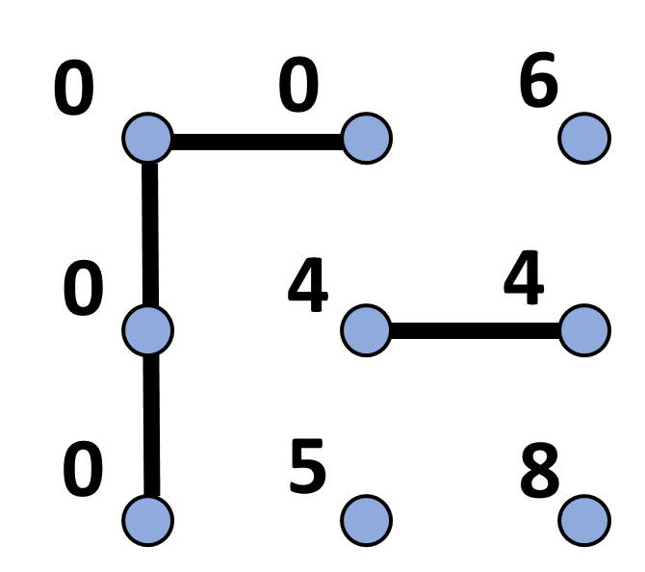
Path Generation
Use Connected Component Number (CN)

Slide 61



Path Generation
Rules for vertical edges and horizontal edges on each column
Rule 1
Rule 2
Column i
Column i
Column i
Prevent Loops
Prevent Junctions
Notes:
1: prevent loop. 2: prevent junction

Slide 62


Path Generation
Rules for vertical edges and horizontal edges on each column
Rule 3
Rule 4
Column i
Column i
Prevent Junctions and Disconnects
Notes:
3: prevent disconnect 4: prevent disconnect, junction

Slide 63

Desired Path Generation
By Path Enumeration

Slide 64



Maze Generation Driven by Solution Path
When we have desired solution path on a maze,
Does maze have the solution path?
No guarantee to have the desired maze

Slide 65


Maze Generation Driven by Solution Path
When we have desired solution path on a maze,

Slide 66
Design-Centric Maze Generation
Three Stages
Input
Maze & Solution Path Generation
Output
Notes:
In this tool,,,,

Slide 67

Output
Return single maze or set of mazes
Users can choose one amongst

Slide 68
Additionally,
Specifying Hard Constraints
Things we can do beside of setting up desired metric values

Slide 69



Specifying Hard Constraints
Maze - Path Constraint
Force maze to pass through
Notes:
Directly specify paths over a grid

Slide 70
Specifying Hard Constraints
Maze - Path Constraint
Solution Path as Hard Constraints

Slide 71


Specifying Hard Constraints
Maze - Non-Path Constraint
Force maze NOT to pass through
Notes:
Directly speicify non-paths over grid

Slide 72


Specifying Hard Constraints
Solution Path - Start and End

Slide 73


Specifying Hard Constraints
Solution Path – Path Constraint
Force solution path to pass through

Slide 74


Specifying Hard Constraints
Solution Path - Non-Path Constraint
Force solution path NOT to pass through

Slide 75

Maze Design Tool

Slide 76
Performance Demonstration
Provide use-cases of game level creation
Notes:
Shows how our design centric method can be used in game content creation

Slide 77

Use-Case 1
Plumbing Puzzle Game
https://ko.y8.com/games/plumber_game

Slide 78
Use-Case 1
Input
6x6 Grid
#T-Juncs=85%

Slide 79

Use-Case 1
Solved One
Unsolved One by Rotating Tiles

Slide 80


Use-Case 2
Running Game
https://zwift.com/run
https://zwift.com/run

Slide 81

Use-Case 2
Input
12x6 Grid (two 6x6 mazes)
SolutionPathLength=50%
#T-Junctions=75%
Hard Constraints

Slide 82


Use-Case 2
Maze
Game Level

Slide 83
Performance Demonstration
Error: Average distance of top 10 mazes of 1,000 generated mazes to desired maze
Return desired mazes in reasonable time
Game | Error | Time to Generate 1,000 Mazes
Plumbing | 0.0 | 0.13s
Running | 0.0 | 0.51s

Slide 84
Conclusion
Introduced our design-centric maze generation method.
Using our method, we can find any desired mazes with good performance.
Users can have detailed control over their content creation.
Notes:
In this presentation, I introduced

Slide 85
Limitation
Unwanted strong features on resulting large mazes
Explore how to extrapolate our representative machines from small grid to large grid

Slide 86
Thank you
Questions?

Slide 87
Higher-Level Properties
Run
River Factor
Bias
Agility Versus Speed
Homogeneity
Hidden Factor
Related to design-centric properties
Notes:
related to more design-centric

Slide 88
Higher-Level Properties
Defining higher-level properties using basic properties
Ex. Agility Versus Speed (AVS)
Low AVS
Mid AVS
High AVS
High Speed Control
High Agility Control
High #Straights
&
Low #Turns
High #Turns
&
Low #Straights
Notes:
related to more design-centric

Slide 89

Path Generation
Path Constraint
All nodes of path except two end points have two adjacent edges

Slide 90
Path Generation
Path Constraint
All nodes of path have two adjacent edges
Virtual
External
Edge
Virtual
External
Edge

